Slide 1
Game design hypothesis
F.U.N. // Insert SpongeBob reference here
CE-810-2

Slide 2
a Balanced game for AI Bots IS easier to play for human players than an unbalanced GAME Where One AI Bot outperforms the others
Hypothesis

Slide 3
a Balanced game for AI Bots IS HARDER to play for human players than an unbalanced GAME Where One AI Bot outperforms the others
Null Hypothesis

Slide 4
What are we considering as a balanced game?
A game where at the end of it, the lives remaining of the winner player is 1 or close to it.
Therefore, an unbalanced game is one where the lives remaining for the winner player is 6 or close to it.

Slide 5
Generating two different games
We use Random Mutation Hill Climber to evolve game parameters to generate two games. The algorithm did 120 evaluations. The AI controllers used were RHCA and FUNT (variation of RHCA with circular buffer that resets randomly the worst individuals in the population and keeps the best ones; it uses the triple parent crossover).
Fitness function used was the one that minimizes the error based on a perfect value (whether it was 1 life or 6 lives remaining of the winner player at the end of the game).

Slide 6
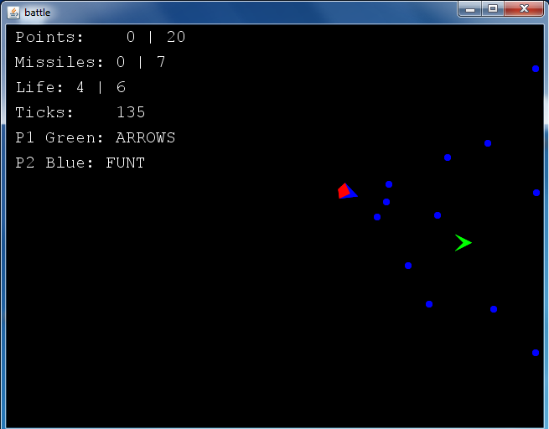
Game A
Missile velocity: 4
Missile radius: 4
Missile time to live: 100
Missile radius: 170
Is missile wrap able: False
Ship scale size: 5
Ship thrust: False
Ship steer step: 10
Ship speed: 3
Game gravity: 0.01

Slide 7
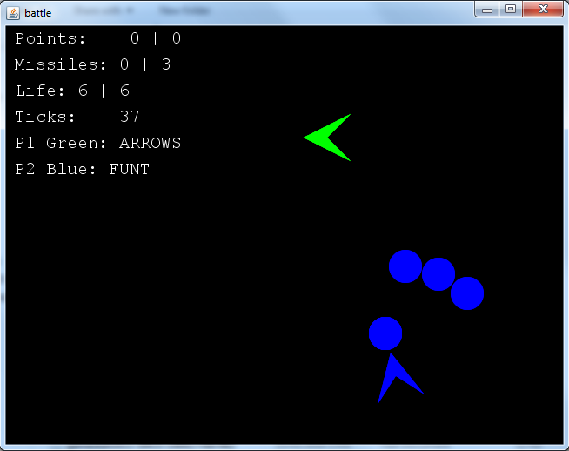
Game B
Missile velocity: 4
Missile radius: 19
Missile time to live: 92
Missile radius: 163
Is missile wrap able: False
Ship scale size: 13.6
Ship thrust: False
Ship steer step: 5
Ship speed: 3
Game gravity: 0.005

Slide 8
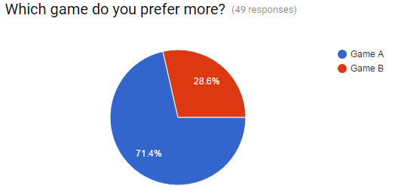
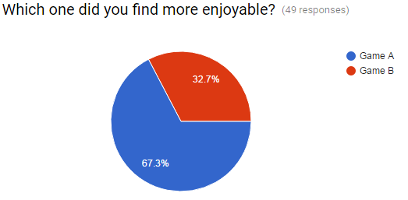
Analysing the qualitative data

Slide 9
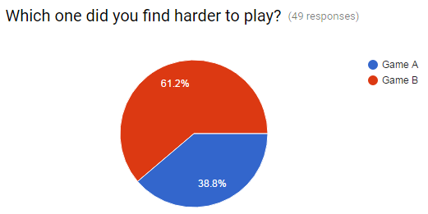
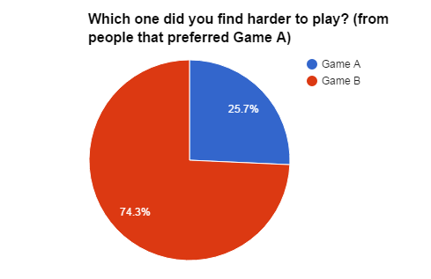
Analysing the qualitative data

Slide 10
Analysing qualitative data
Why the users prefer game A?
More space in order to prepare a strategy (thanks to the smaller ships).
Easier and better ship controls (they feel game B spaceship is too slow).

Slide 11
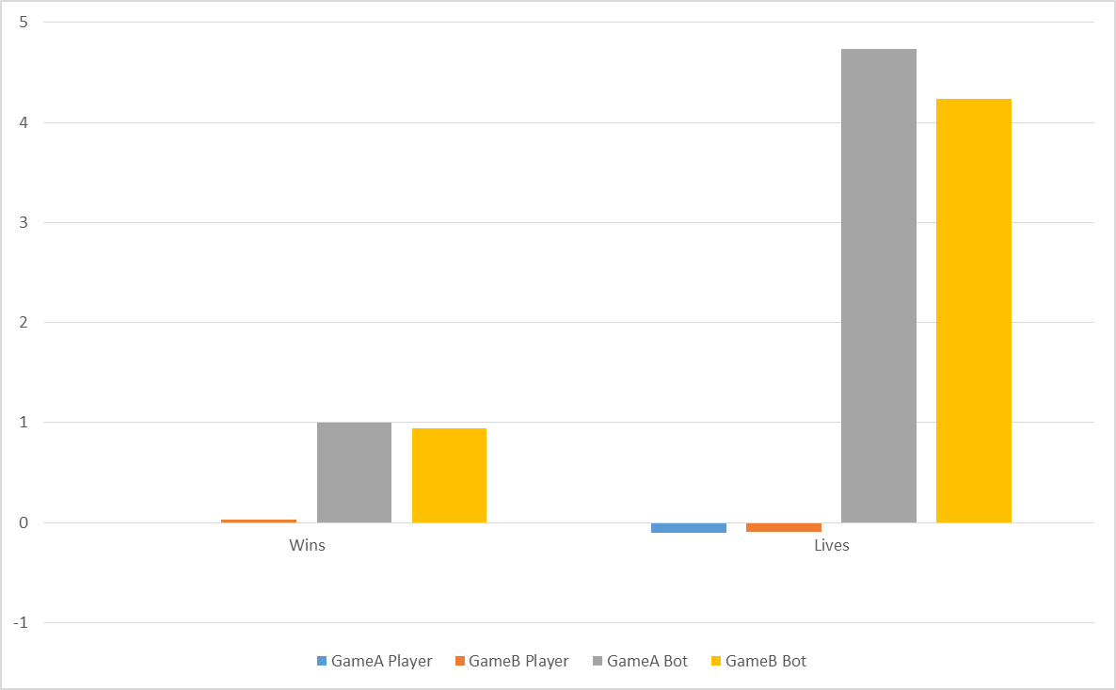
Analysing the game data

Slide 12
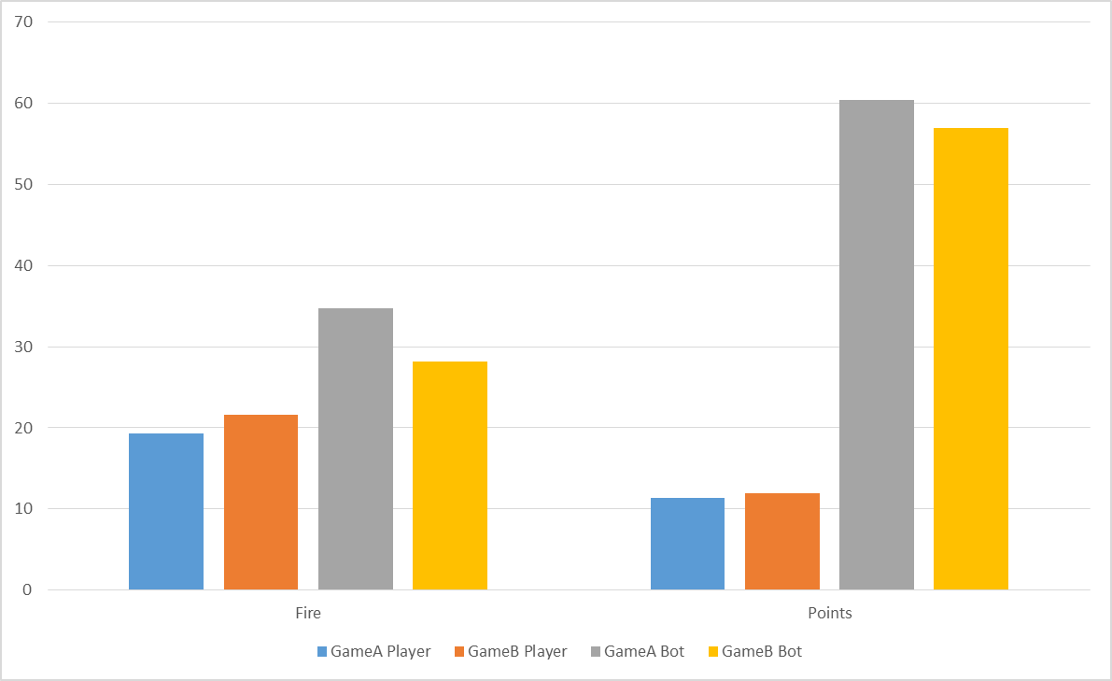
Analysing the game data

Slide 13
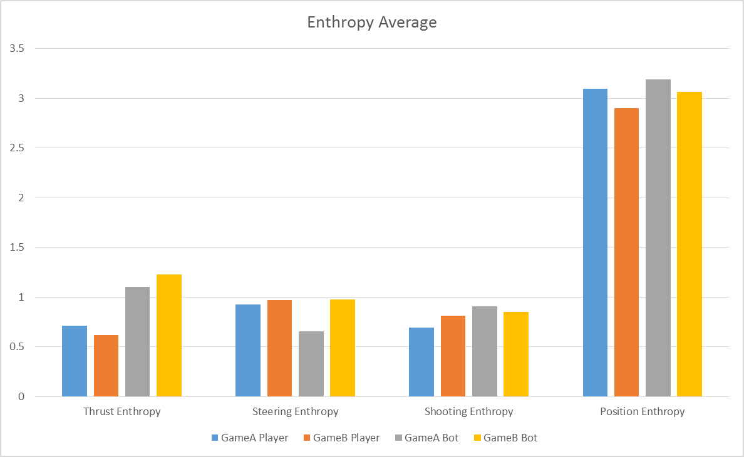
Analysing the game data

Slide 14
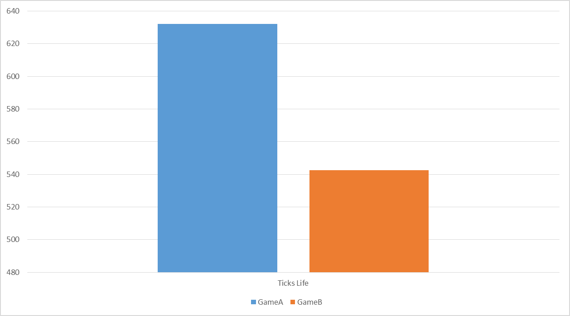
Analysing the game data

Slide 15
Results
The perception of the users is that game B is harder.
The data of both games is showing that there is not a significance difference to state that one game B is easier that game A. It appears to be the other way around.
Based on both qualitative data and game data we accept the null hypothesis based on this set of games:
A balanced game for AI Bots is HARDER to play for human players than an unbalanced game where one AI Bot outperforms the others.

Slide 16
Use Machine learning framework
To predict types of user based on their performance

Slide 17
Framework choose: Random forests
Based on previous experience and experiment, Random forests has the most robust performance in prediction.
It is a boosted Decision tree framework, which create not only one tree but a randomly generated forests to achieve the better performance.
It split the data by some attributes like Ticks, lives, point. Based on entropy it can select the best attribute which can show more information than others.

Slide 18
What do we want to predict based on the player’s record?
What kind of gamer the player is? New-bee? Hard-core gamer? Or just a casual gamer?
Which attribute(s?) can best represent a player’s skill?
Based on their performance in the game, will they like this game? Or choose an alternative one?
Is this a hard game? Can player’s performance tell us this kind of information?

Slide 19
Predict categories of the player
We have two version of the game, we can compare which game can make the Machine-Learning framework easy to predict?
How accurate can we achieve?

Slide 20
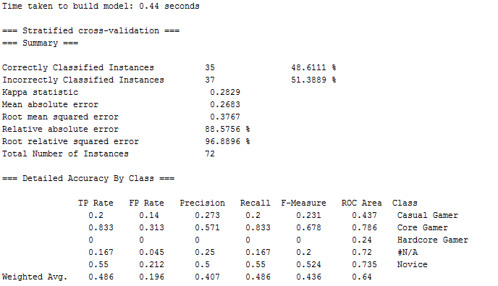
Game A prediction result

Slide 21
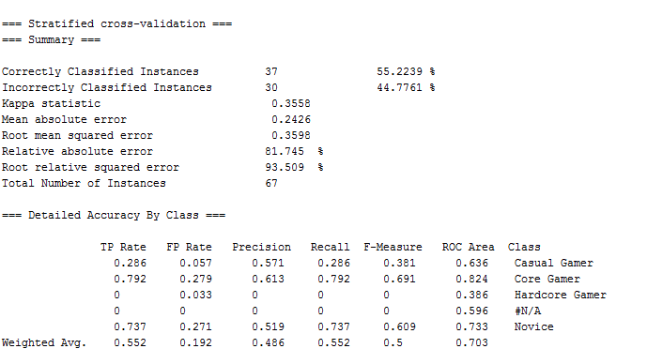
Game B prediction result

Slide 22
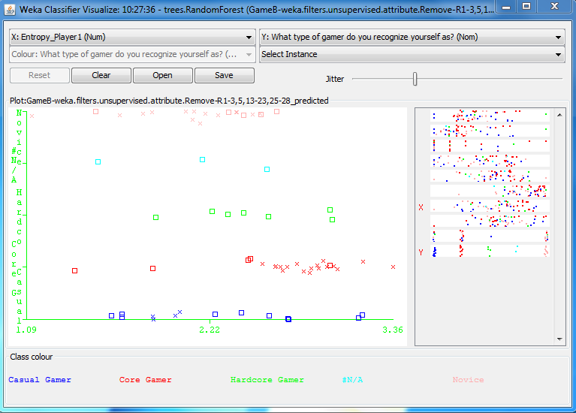
Action Entropy distribution

Slide 23
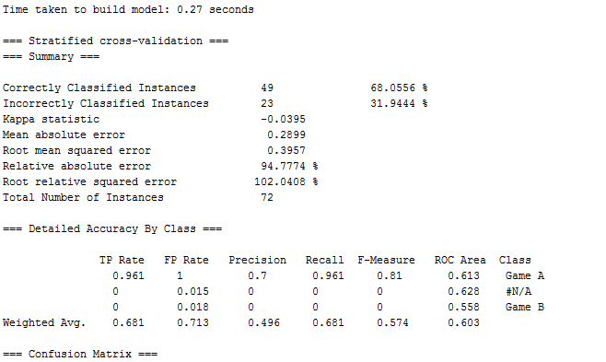
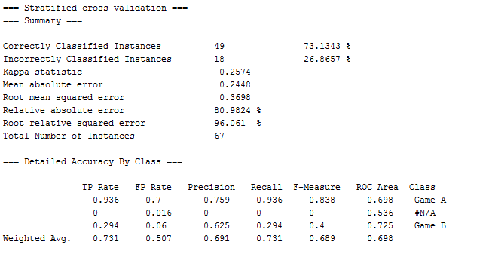
In player preference prediction:

Slide 24
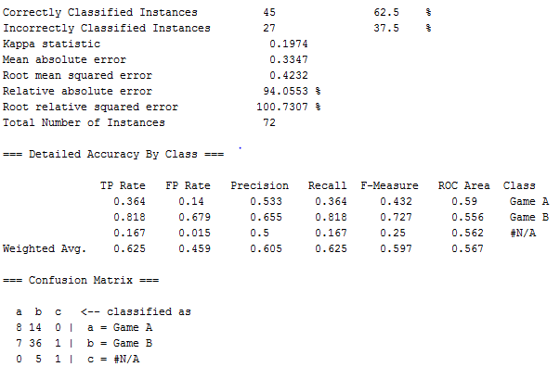
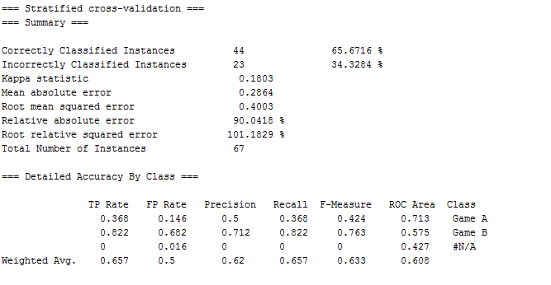
In difficulty prediction:

Slide 25
Conclusions
It is hard, even for AI, to tune the parameters of a game to make it enjoyable and add some skill depth.
Probably, what the AI believes it makes the game easier could not be perceived that way for humans.
Possibly, with a wider set of games, we could reach different results from the one of this experiment.

